Slide 1


AUTOMATED PNEUMONIA DETECTION FROM CHEST X-RAY IMAGES
Instructor: PhD. Hoàng Quang Huy
Group members: Lê Anh Đức - 20224394
Trần Ngọc Lâm - 20233963
‹#›

Slide 2

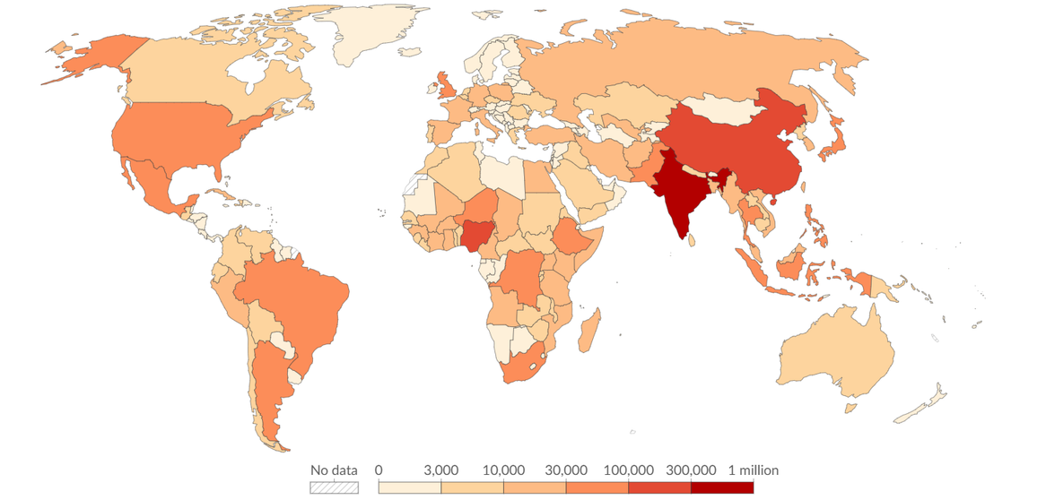
1. Overview
  Pneumonia is an acute respiratory infection causing inflammation in the lung alveoli, filling it with pus and fluid and restricting oxygen intake
  A leading infectious cause of mortality worldwide, especially among young children, the elderly, and immunocompromised patients.
  Chest X-ray (CXR) radiography is the most widely accessible imaging tool used by clinicians to detect the disease
Figure: Deaths from pneumonia in 2023
https://ourworldindata.org/grapher/deaths-from-pneumonia
‹#›

Slide 3
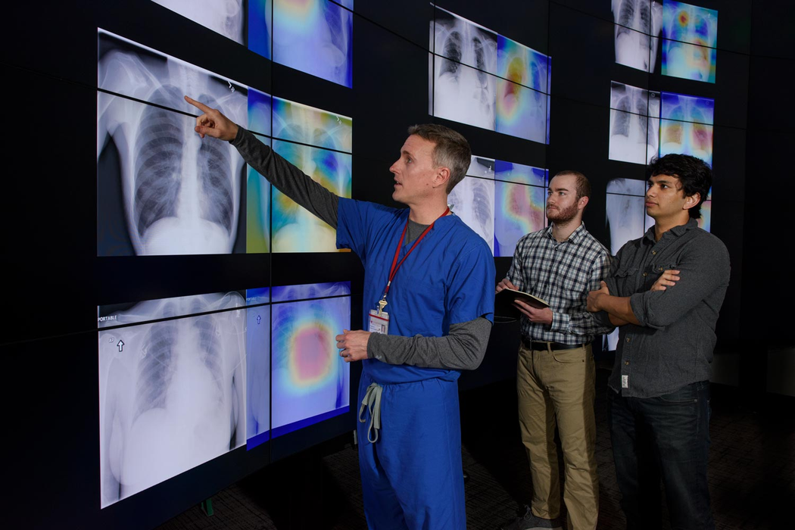
2. Problem Statement
  High daily volume of chest X-rays leads to diagnostic delays and fatigue for radiologists in hospital emergency departments.
  Interpreting chest radiographs is subjective, with high intra- and inter-observer variability, especially in early-stage cases.
  Shortage of expert radiologists in rural and low-resource medical centers leads to missed or delayed diagnoses.
  Unchecked diagnostic errors or delayed triage can lead to rapid disease progression and severe clinical outcomes.
Figure: https://news.stanford.edu/stories/2017/11/algorithm-outperforms-radiologists-diagnosing-pneumonia
‹#›

Slide 4
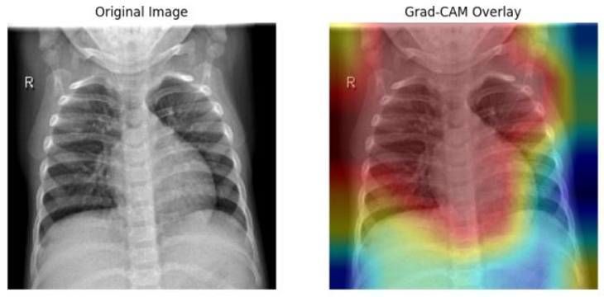
3. Proposed Solution
  Computer Vision model leveraging Deep CNNs for automated classification (Normal vs. Pneumonia) from X-ray images
  Technical Architecture:
    Preprocessing: Image contrast enhancement (CLAHE) to highlight pulmonary consolidations
    Core Model: Transfer Learning with ResNet-50 / EfficientNet
  Explainable AI (XAI): Integration of Grad-CAM heatmaps to highlight exact lesion areas
=> Accelerates emergency triage, provides an objective "second reader," and improves diagnostic accuracy in primary care settings
Figure: A chest X-Ray image and its Grad-CAM overlay
https://www.researchgate.net/publication/392885063_Ensemble_Deep_Learning_Approach_for_Pneumonia_Detection_Using_DenseNet_MobileNet_and_EfficientNet_with_Transfer_Learning
‹#›

Slide 5
4. Preprocessing
  NIH Chest X-rays: https://www.kaggle.com/datasets/nih-chest-xrays/data
    112,120 X-ray images with >90% accurate labels from 30,805 patients, mostly adults
    Natural Language Processing was used to text-mine classifications from radiological reports
    Because of the gigantic amount of images, only 2,000 of them (1,000 pneumonia, 1,000 “no finding”, 2.52 GB in total) are used, streamed from HuggingFace: https://huggingface.co/datasets/chehablab/NIHChestXR/viewer
  Chest X-Ray Images (Pneumonia): https://www.kaggle.com/datasets/paultimothymooney/chest-xray-pneumonia
    5,863 X-Ray images (1,583 Normal, 4,272 pneumonia)
    Images were selected from retrospective cohorts of pediatric patients of 1-5 years old from Guangzhou Women and Children’s Medical Center, Guangzhou
    All radiographs were screened for quality control and graded by two expert physicians before being cleared for training. The evaluation set was checked by a third expert to account for any grading errors
  Split: patient-level, stratified by source and class; NIH uses real patient IDs.
    Guangzhou: 4,157 train, 808 test, 890 val
    NIH: 1,434 train, 279 test, 287 val
‹#›

Slide 6
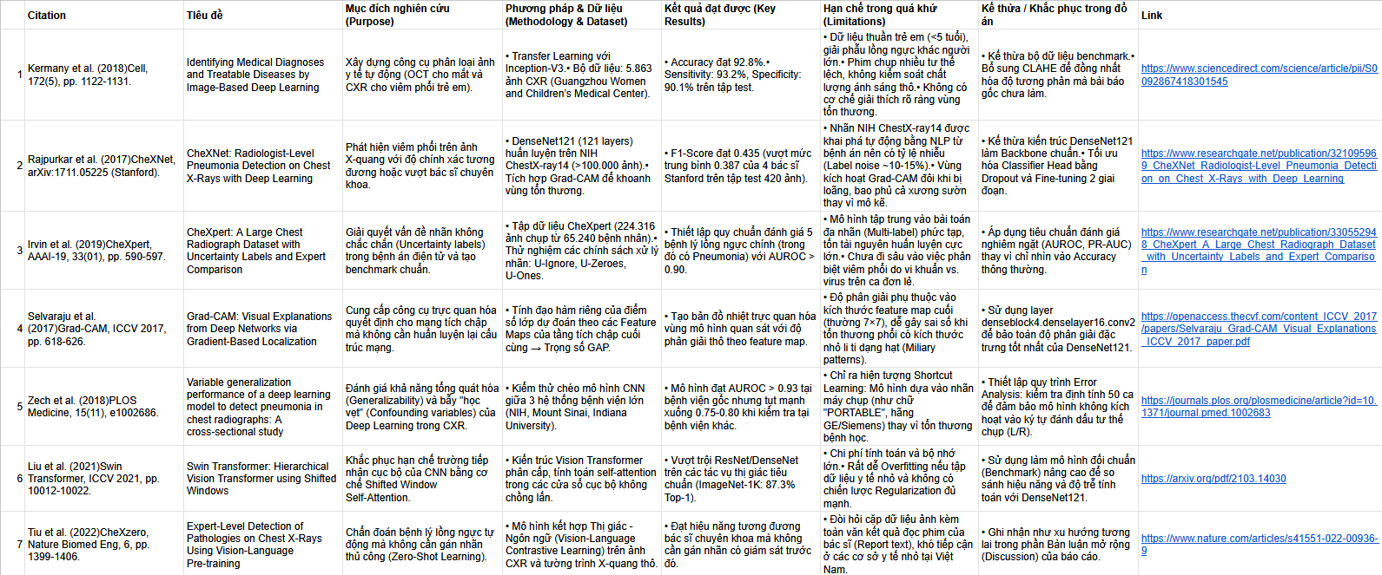
5. Literature Review
‹#›

Slide 7
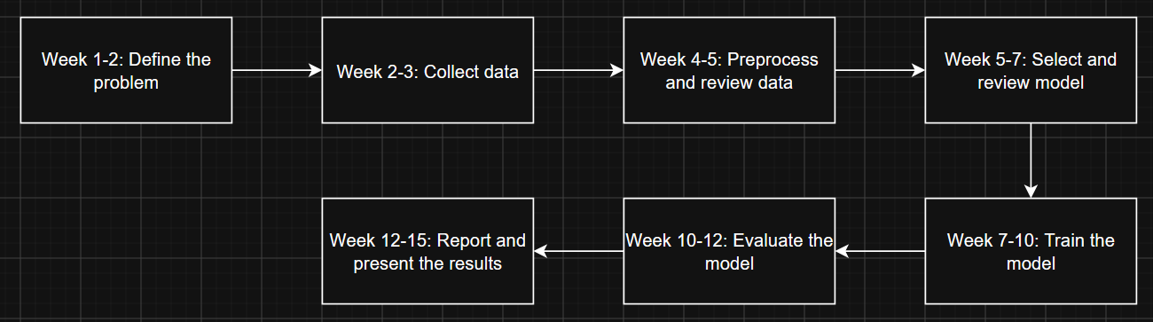
6. Timeline
‹#›

Slide 8
7. Preprocessing
  Dataset construction:
    Guangzhou artifact-matched [say what you matched on]: kept 1982 of 5855 images (991 normal / 991 pneumonia)
    NIH subset: 1000 no-finding / 1000 pneumonia
    Both sources are 50% pneumonia, so a source-only baseline gives AUROC 0.5
  Grayscale Loading: Images are loaded in grayscale format (cv2.IMREAD_GRAYSCALE)
  Optional Center-Square Crop: Off by default (SQUARE_CROP = False), cutting a center square to remove class-dependent squashes and black borders
  CLAHE (Contrast Limited Adaptive Histogram Equalization): Applied to enhance local contrast.
  Resizing: Images are resized to 224 x 224 pixels using area interpolation (cv2.INTER_AREA)
  Channel Replication: The single-channel processed image is stacked into 3 identical channels to match standard model architectures
  Data Augmentation & Normalization:
    Training data undergoes random resized cropping and random rotation via train_tf
    Validation and test data bypass augmentation, using only tensor conversion and ImageNet mean/standard deviation normalization via eval_tf
‹#›

Slide 9
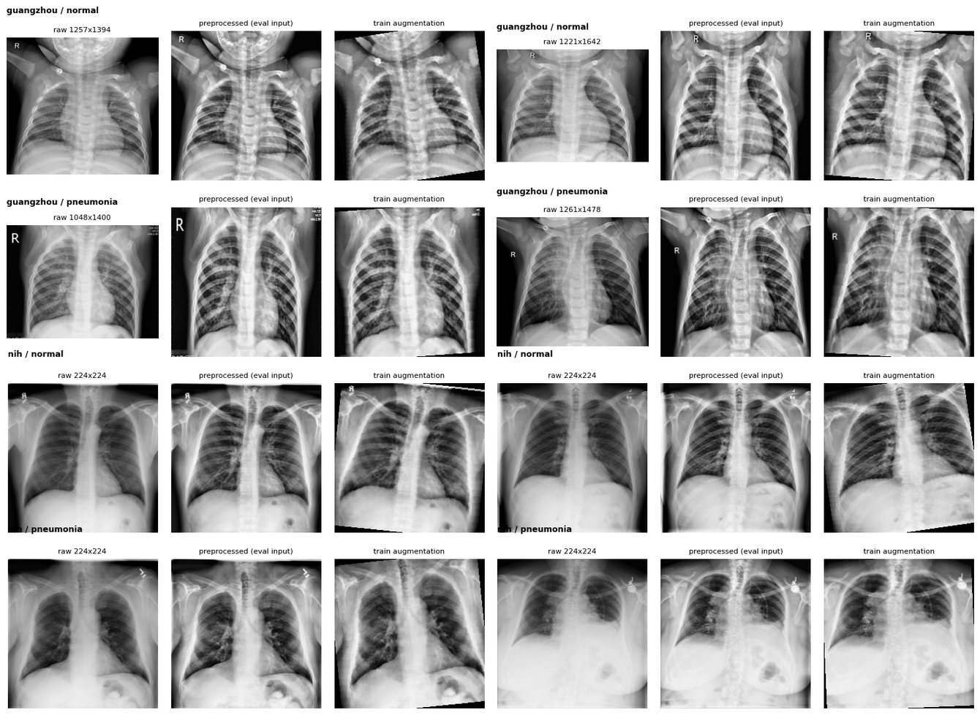
7. Preprocessing Results
‹#›

Slide 10
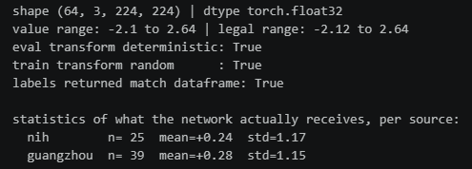
7. Preprocessing
  Output tensor characteristics:
    Batch Tensor Shape: (64, 3, 224, 224) with torch.float32 datatype.
    Value Ranges: Actual value range spans from -2.1 to 2.64 within the legal range -2.12 to 2.64
    Per-Source Statistics:
      Guangzhou: Mean = +0.24, Standard Deviation = 1.17 (n = 25)
      NIH: Mean = +0.28, Standard Deviation = 1.15 (n = 39)
‹#›

Slide 11
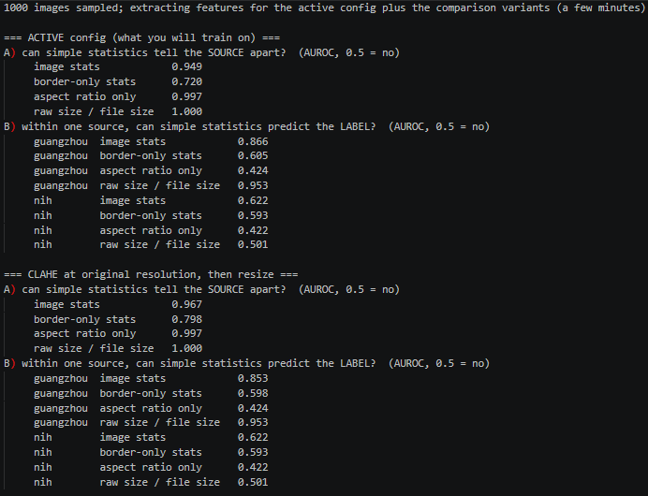
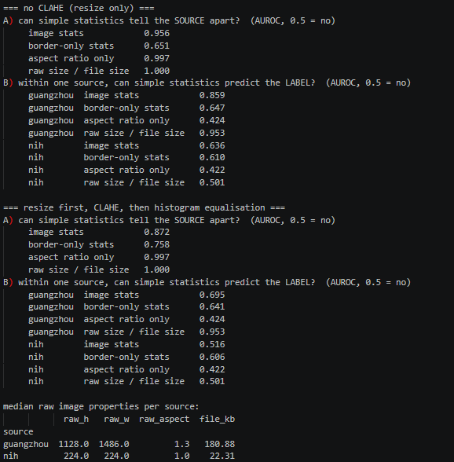
7. Preprocessing
‹#›

Slide 12

8. Training
  Guangzhou and NIH are each split by patient into train/val/test (about 71/14/14) separately per source
  Model and optimiser:
    ImageNet and EfficientNet-B0 with a one-logit head, all layers trainable
    Loss is weighted binary cross-entropy optimised with AdamW with learning rate of 0.0002 and a cosine schedule over 4 epochs, batch size 32, on CPU
  After each epoch it computes validation AUROC per source and keeps the epoch with the best average of those, so the easy source can’t dominate
  Afterwards: it reloads the best checkpoint and picks decision thresholds on validation images. It then evaluates on test with patient-level bootstrap CIs, a centre-masking check, a self-check table and a near-duplicate audit
‹#›

Slide 13
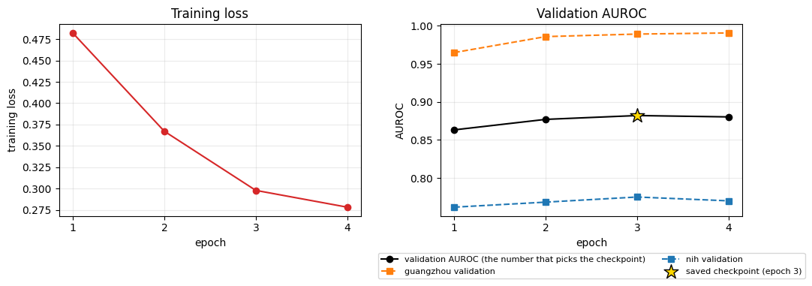
8. Training
‹#›

Slide 14
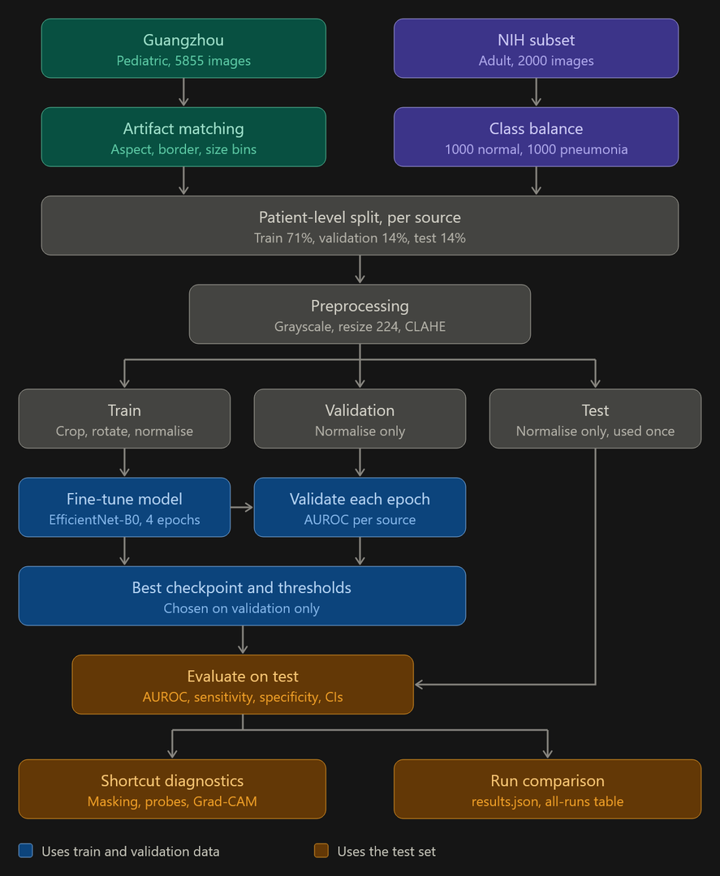
9. Pipeline
‹#›

Slide 15
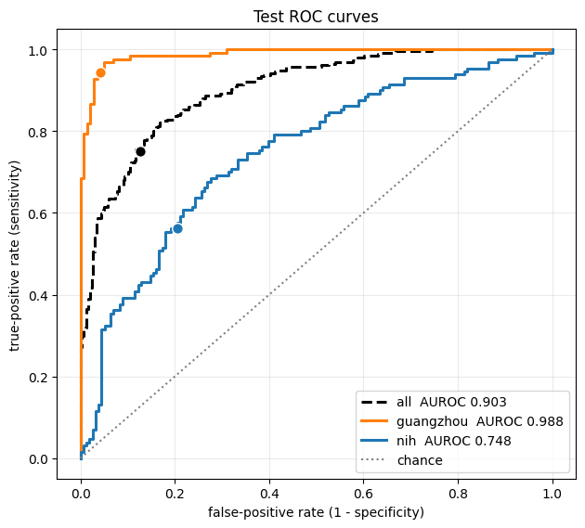
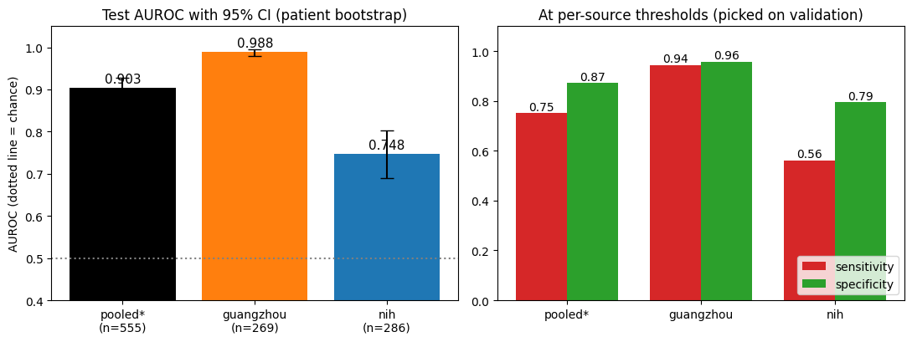
10. Results
‹#›

Slide 16
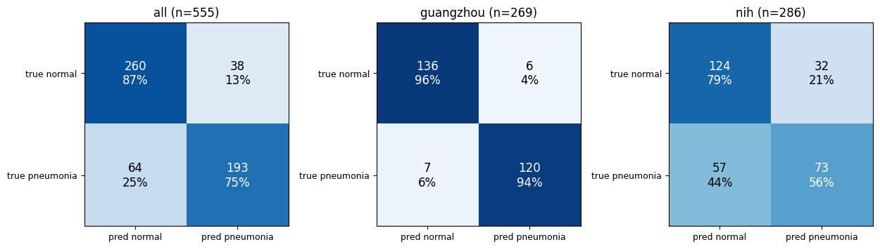
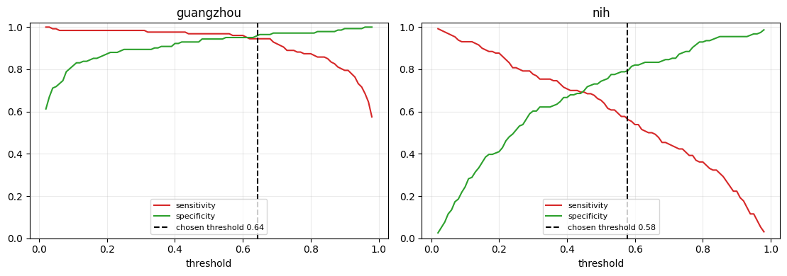
10. Results
‹#›

Slide 17
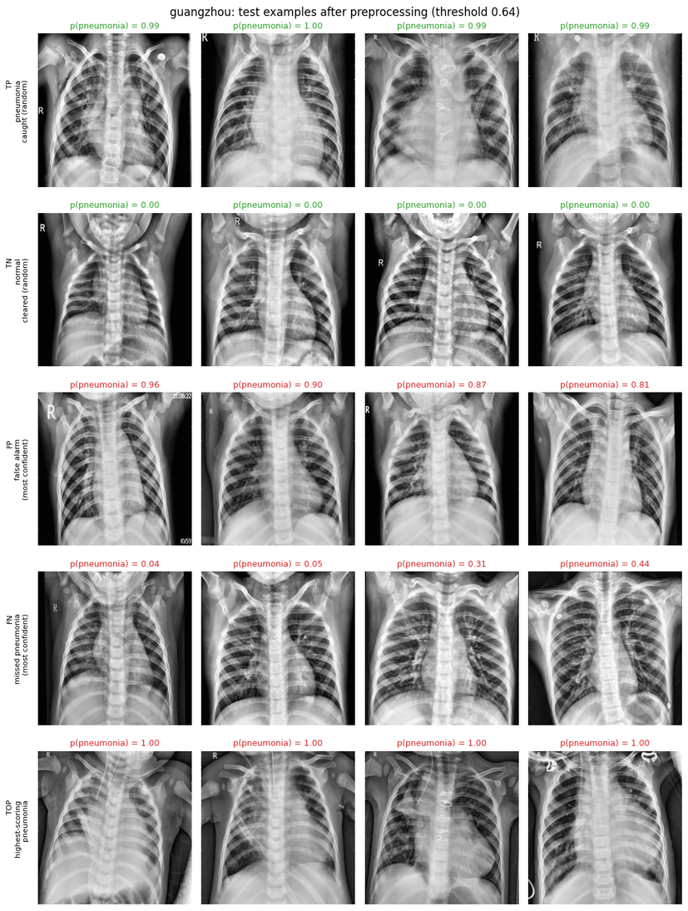
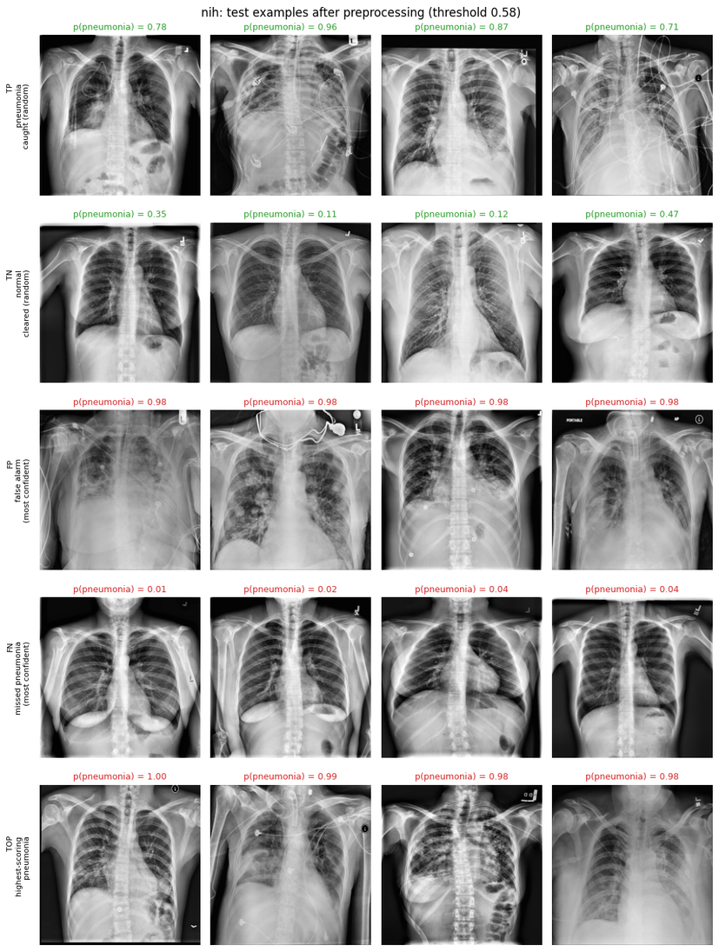
10. Results
‹#›

Slide 18

THANK YOU !
‹#›

